Slide 1
Electric Water Heater

Slide 2
Team Members :
Nourhan Mohamed Alrefaei
Sodfa Ayman Elemam
Asmaa Mohamed Ibrahim

Slide 3
Overview
It’s an Electric Water Heater that we made using AVR (Atmega32a) in addition to some of the hardware modules such as (Seven Segment-ADC-LM35(Temperature Sensor)-EEPROM-BUTTONS-LEDS-DC MOTOR & Timers).
The Controller follows the following procedures:
1. It has the ON/OFF Button that is attached to an external interrupt, that switches between ON and OFF states.
2. in the OFF state everything is Off, the desired temperature is saved in the EEPROM, and the MC is in sleep mode.
3. in the ON state, the MC senses the actual temperature using the internal ADC and temperature sensor (LM35) and saves it to an array.
4. the array consists of the last 10 readings used to decide to turn the heater/cooler on and off depending on their average.

Slide 4
5. the UP and DOWN buttons are to switch from the ON state to the SETTINGS state, where the user can modify the desired temperature.
6. UP Button increases the Setting temperature by 5 degrees and the DOWN Button decreases the Setting temperature by 5 degrees.
7. if the user didn't click the UP or DOWN buttons for five seconds, it turns back to the ON state, and the chosen temperature is saved in the EEPROM once again.
8. The indication led is to know which element (Heater or Cooler) is working and in what state is the controller in.

Slide 5
Components :
Hardware:
EEPROM
Temp sensor (LM35)
Cooling Element
Heating Element
7-Segments
LED
Push Buttons
Fan
Software:
Atmel Studio
Proteus

Slide 6
External EEPROM
Up Button
Heating Element Led
Down Button
7-Segment
Micro Controller
ON/OFF
Button
Heating Element
Temperature Sensor
Cooling Element

Slide 7
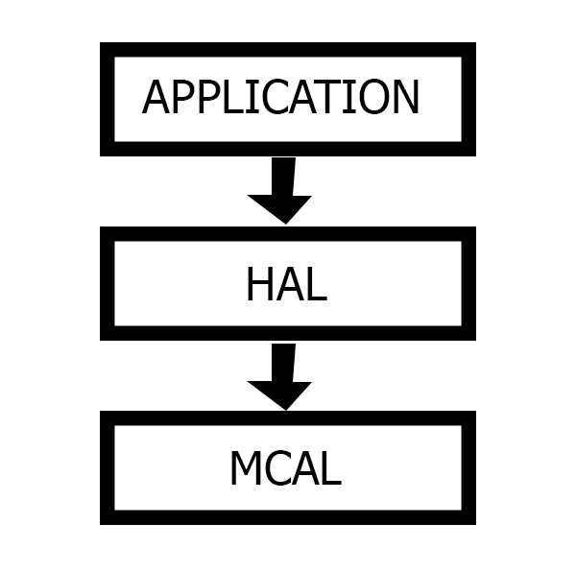
Project Detailed Design:
Project Static Architecture:
1. MCAL: includes (ADC, Internal EEPROM, and Timers) driver.
2. HAL: includes hardware components (7-segment, Led,
Button, Temperature Sensor(LM35), Heat & Cool Elements)
driver.
3. App Layer: Calls MCAL, and HAL directly.
System Initialization:
1. Initialize the system by initializing all modules (ADC, Timers,
7-segments, Cooler, Heater, Buttons, Led).
2. Set the initial temperature to the EEPROM (if it is the
first time run the microcontroller the initialization function will set the initial temperature
at EEPROM with the value of 60 degrees).
3. Initialize the current state of the system in the off mode which means all the hardware elements are off
4. initialize temperature array (temp_arr) which is an array of 10 elements each element is a temperature
measure every 100ms so, at first we initialize all the elements of this array with the value saved in
EEPROM (if it is the first time running the microcontroller the initialization function will set all elements
of the array with the value of 60 degrees as an initial value.

Slide 8
3. ON State:
1. This is the working state. If the system is in an off state and you press the ON/OFF Button is
which is connected to the external interrupt pin in atmega32a. The system will be turned from OFF state
to ON state.
2. ON state does the following :
1. Waits for the timer to measure the temperature using ADC every 100ms.
2. Checks for UP & DOWN buttons to switch to the setting state.
4. OFF State:
1. In this state all peripherals are turned off, and the timer is off.
2. The microcontroller will be in sleep mode where the CPU is in idle mode to save more power when it
doesn’t need to do any task at this moment.
5. SET State: The System will enter this state if there is any press on the Up or Down Buttons. The set
does the following:
1. If the up button is pressed the desired temperature will be increased by 5 degrees.
2. If the down button is pressed the desired temperature will be decreased by 5 degrees.
3. After entering the Set state if there is not any press until 5 seconds the system will turn to the on
state.
4. Every second in this state the seven-segment toggle displays the desired temperature.

Slide 9
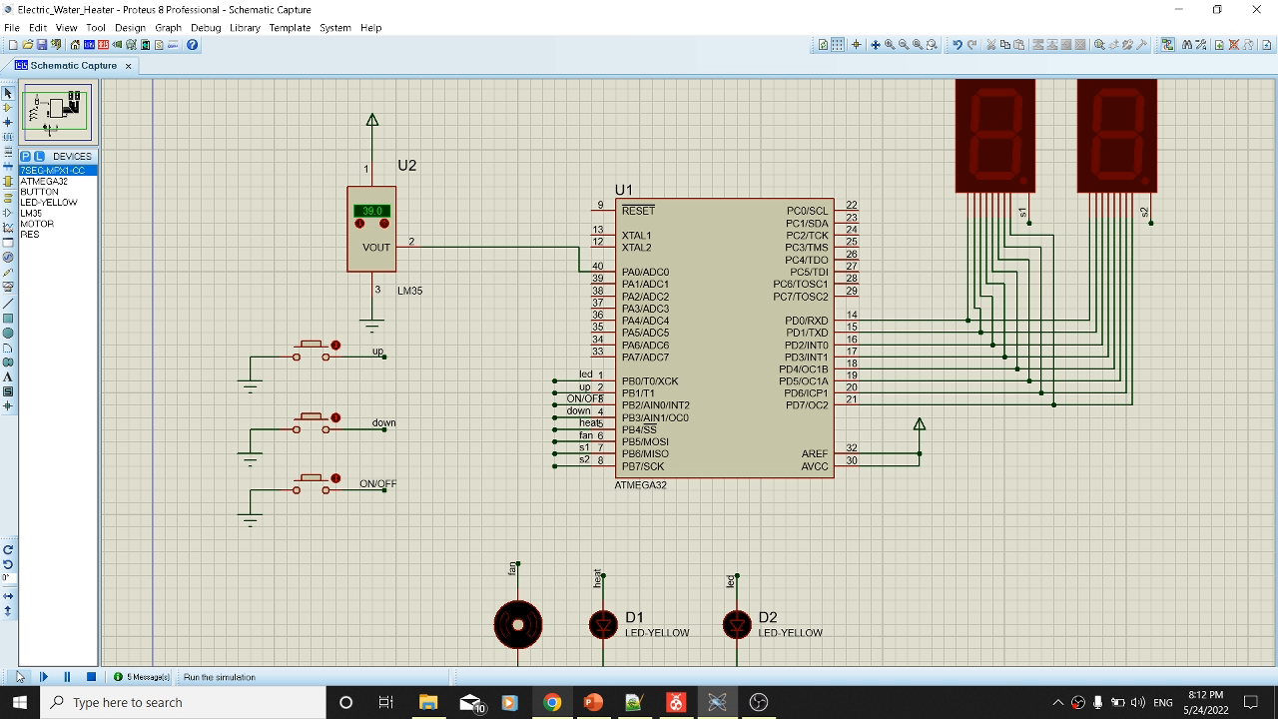
Simulation

Slide 10

Thank you!
Any questions?

